Slide 1




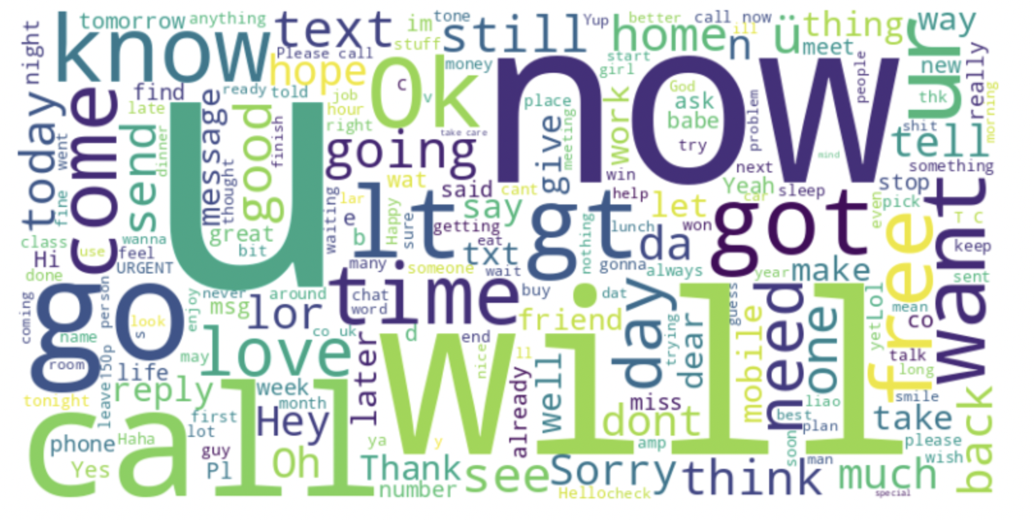
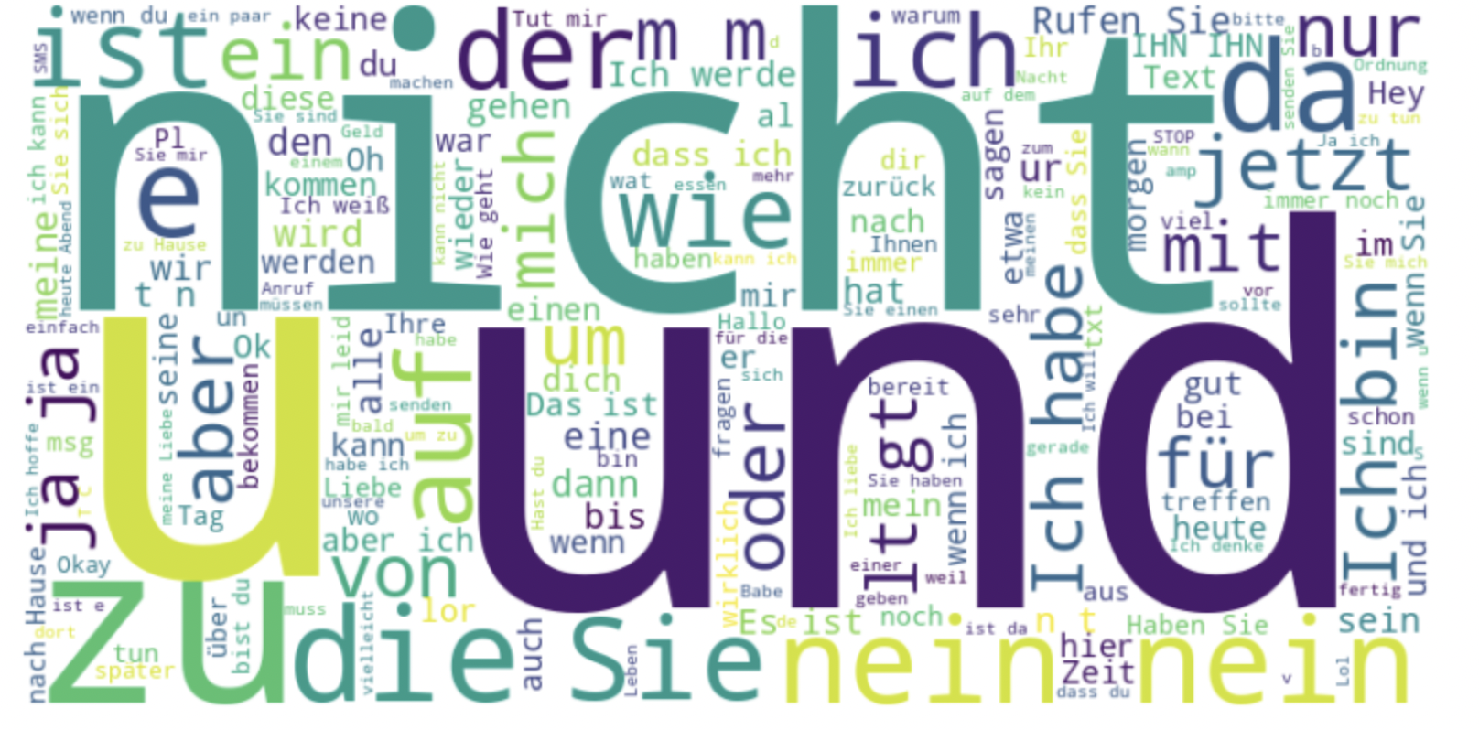
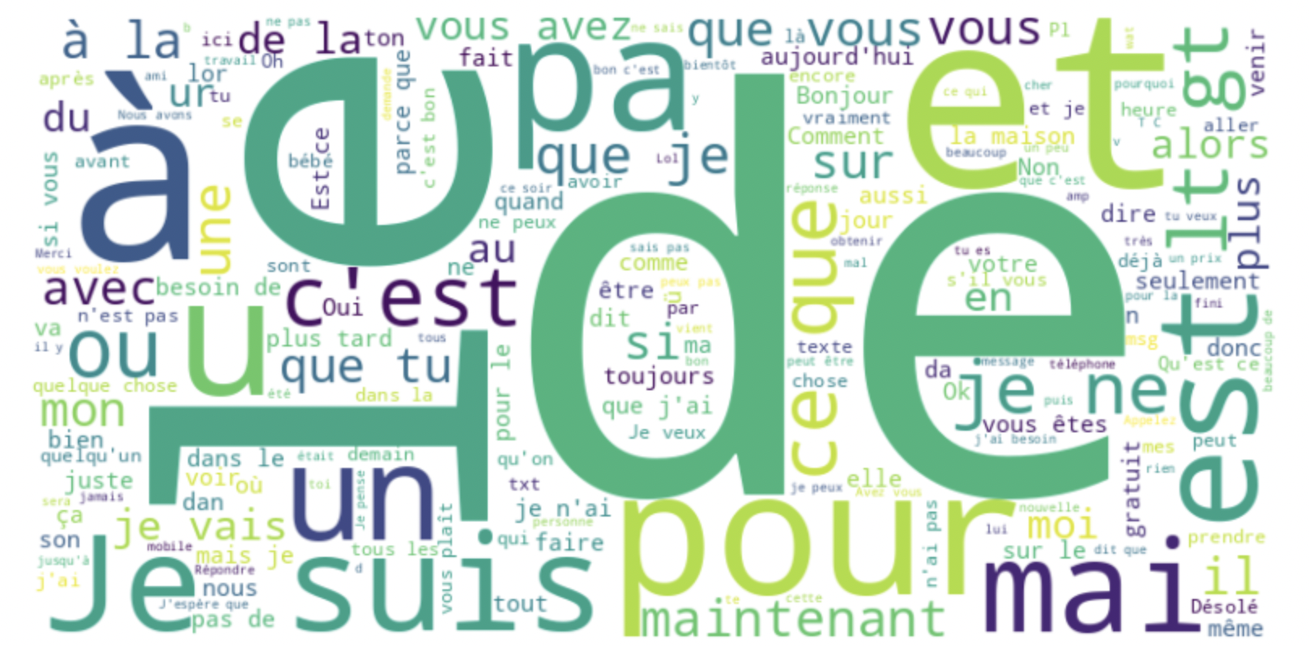
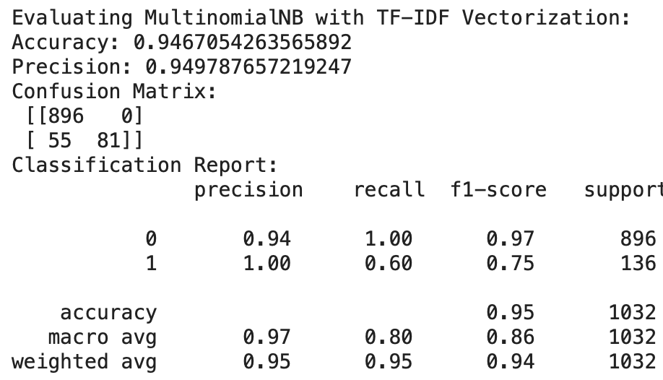
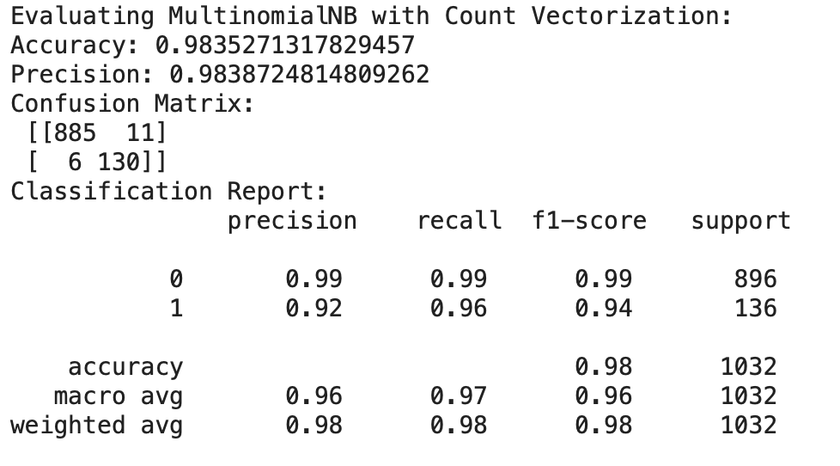
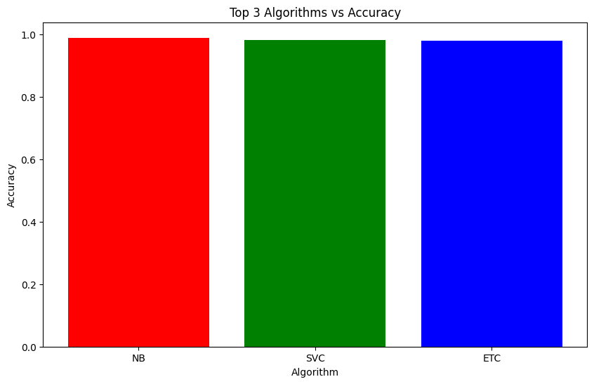
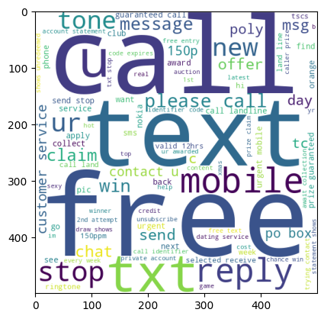
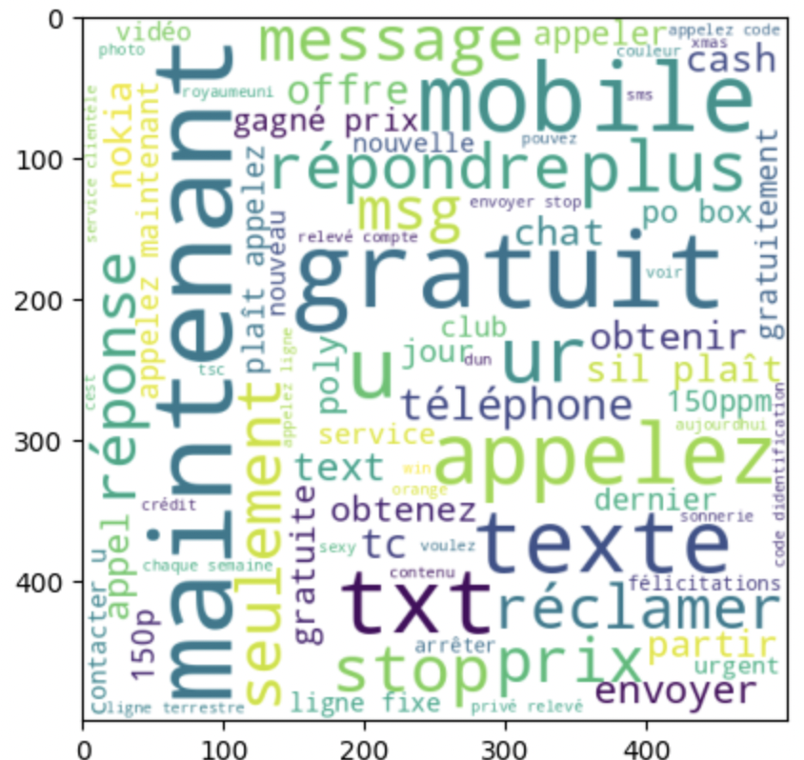
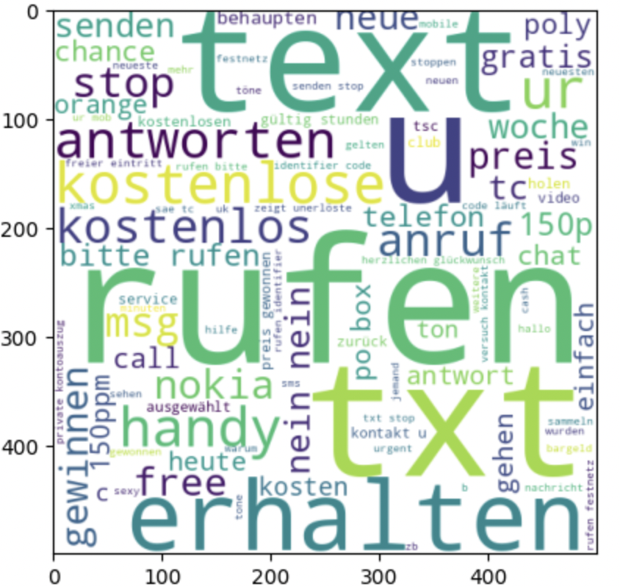
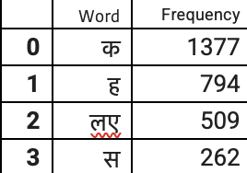
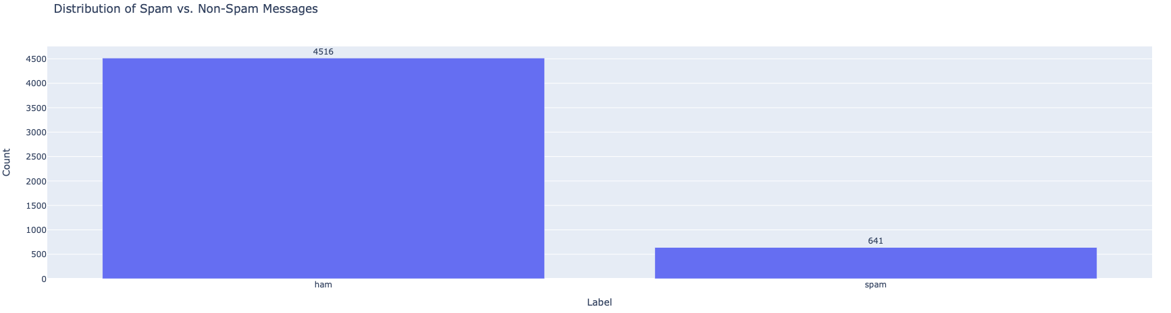
Multilingual Spam Detection Model
Student: Mihika Mishra
Analytics Capstone Project, Pace University
Abstract
Word cloud for text
MultinomialNB Model
Result
.
Spam, in its various forms from unsolicited ads to phishing scams, is a widespread issue that threatens online communication security, necessitating robust detection systems that transcend language and cultural barriers. Various government departments handle requests based on the issue.
The global linguistic diversity poses a challenge to traditional spam filtering methods, which are primarily designed for English-speaking users.
The goal is to understand linguistic and cultural setting across multiple languages to effectively identify spam filter.
The word cloud for English text where “now” ,”U” , “will”, “call"," go” etc. are prominently used in spam messages
The MultinomialNB model excelled in identifying common classes but struggled with lower recall for positive instances.
When using Count Vectorization, the model showed marked improvements in recall for the positive class, enhancing accuracy.
The model maintained perfect precision for positive predictions across both vectorizations, confirming its reliability when identifying positive cases.
Count Vectorization helped the model robustly handle both positive and negative classes, reducing false positives and negatives.
Highest Performing Models:
Naive Bayes (NB) achieved the highest accuracy of 98.93% and perfect precision.
k-Nearest Neighbors (KN) had lower accuracy at 91.18% but achieved perfect precision.
SVC (Sigmoid Kernel) demonstrated high accuracy at 98.16% and precision at 99.09%.
Consistently High Precision: Most models achieved very high or perfect precision, indicating strong performance in correctly predicting positive classes when they do.
Variability in Accuracy: There was some variability in accuracy, with Decision Tree and Gradient Boosting showing relatively lower accuracy compared to ensemble methods and SVM.
The word cloud for French text where “now” ,”U” , “will”, “call", "go” etc. are prominently used in spam messages
The word cloud for German text where “de” ,”e” , “pour”, “a”,”suis” etc. are prominently used in spam messages
Introduction
Most Frequent Words used in Spam
The "Multilingual Spam Detection Model" addresses the global challenge of spam across diverse linguistic contexts by utilizing advanced machine learning techniques.
This model integrates cultural and linguistic nuances to enhance detection accuracy.
Aimed at achieving over 95% accuracy, the model leverages a comprehensive dataset of multilingual communications to ensure robust and scalable spam detection.
This project outlines the model's conceptual framework, development methodology, and analytical strategies.
Models
Conclusion & Future Work
Support Vector Machine: Achieved an impressive accuracy of 98.16% using a sigmoid kernel, demonstrating strong robustness in text data handling.
k-Nearest Neighbors: Recorded 91.18% accuracy with perfect precision, indicating high reliability for positive class predictions.
Naive Bayes: Exhibited excellent accuracy (98.93%) and precision, making it highly suitable for text classification.
Decision Trees: Showed lower effectiveness with 94.67% accuracy, potentially due to overfitting with a maximum depth of 5.
Logistic Regression and Random Forest: Both
models displayed strong accuracy and precision,
achieving 96.32% and 97.87% respectively,
indicating good generalization.
AdaBoost: Had a slightly reduced accuracy of 97.09%, which may be due to sensitivity to noisy data inherent in boosting methods.
Extra Trees: Nearly matched the top classifiers with 97.97% accuracy, showing excellent performance.
Gradient Boosting and XGBoost: Both techniques had robust performance with accuracies of 96.03% and 97.77% respectively, though slightly lower than the top models
.
Utilizes advanced natural language processing and machine learning models to analyze text in multiple languages.
Shows strong capability in distinguishing spam from non-spam using models like Multinomial Naive Bayes and Support Vector Machines.
Employs TF-IDF and count vectorization to refine text classification across languages.
Data Collection
These are the most common words used in spam in all four languages that is English ,French, German and Hindi.
The words include call, text, free, rufen , txt , gratuity respectively. We can also see that some words meaning are similar in different language and some are different which tells us about cultural difference
The Multilingual Spam Detection use large and diverse dataset to recognize spam in a variety of languages.
The dataset include wide range of languages ,such as Hindi , English , French and German in text message format.
The dataset has Target variable as label as ham and spam with four textual language data
Implementing real-time spam detection capabilities and integrating user feedback can help in continuously refining the model's accuracy. Further exploration of advanced feature engineering techniques and rigorous model tuning could enhance the system's effectiveness and scalability for diverse applications.
Feature Extraction
Feature extraction is a critical step in natural language processing, to distinguish between relevant and irrelevant features can determine the model's effectiveness Texts are broken down into basic components or tokens, such as words or significant elements. Common, uninformative words like "and", "is", and "in" are removed to improve feature relevance.
Words in languages like German and French are reduced to their root forms using grammatical rules. This method transforms text into a matrix of features, adjusting word relevance based on frequency across documents. This identifies typical conversational patterns and common words in multiple languages, enhancing the detection of informal communication in English, conversational verbs and pronouns in Hindi, personal expressions in German, and regular dialogue elements in French
Distribution of spam VS non- spam
References
1. Labonne, M., & Moran, S. (2023). Spam-T5: Benchmarking Large Language Models for Few-Shot Email Spam Detection. ArXiv. /abs/2304.01238
2. Mallikarjunappa, Basavaraju & Prabhakar, Dr. (2010). A Novel Method of Spam Mail Detection using Text Based Clustering Approach. International Journal of Computer Applications. 5. 10.5120/906-1283.
3. Hadj Ahmed Bouarara, Reda Mohamed Hamou, and Abdelmalek Amine. 2015. A Novel Bio-Inspired Approach for Multilingual Spam Filtering. Int. J. Intell. Inf. Technol. 11, 3 (July 2015), 45–87. https://doi.org/10.4018/IJIIT.2015070104
4.Bouarara, Hadj Ahmed & Hamou, Reda & Rahmani, Mohamed & Amine, Abdelmalek & Rahmani, Amine. (2015). A New Bio-Inspired Technique of Artificial Social Cockroaches for Spam Detection with Visual Result Mining.

